Slide 1

Group 1
Technology Store Management

Slide 2
Group 1
Technology Store Chain Management
Group 1
This project focuses on providing a comprehensive management system for technology retail chains, offering businesses efficient solutions to streamline buying and selling processes in the competitive e-commerce environment. Designed to optimize key operations such as merchandise management, inventory control, and payment tracking, the system ensures seamless business operations. By offering powerful tools for sales management, real-time inventory updates, and revenue analysis, it helps businesses improve efficiency, plan restocking, and make informed decisions. With features that enhance customer engagement and support effective marketing strategies, this system gives technology businesses a competitive edge, enabling them to thrive in an ever-evolving market.

Slide 3
Team members
Technology Store Management
Group 1
This project focuses on providing a comprehensive management system for technology retail chains, offering businesses efficient solutions to streamline buying and selling processes in the competitive e-commerce environment. Designed to optimize key operations such as merchandise management, inventory control, and payment tracking, the system ensures seamless business operations. By offering powerful tools for sales management, real-time inventory updates, and revenue analysis, it helps businesses improve efficiency, plan restocking, and make informed decisions. With features that enhance customer engagement and support effective marketing strategies, this system gives technology businesses a competitive edge, enabling them to thrive in an ever-evolving market.
Technology Store Management
Nguyen Dinh Chien
Nguyen Minh Quang
Dao Duc Thien
Le Trung Kien
Tran Bao viet

Slide 4
Team members
Leader DBA - BE
Le Trung Kien
Design FE - BE
Nguyen Dinh Chien
Nguyen Minh Quang
Nguyen Thi Yen
BackEnd – FontEnd
BackEnd – FontEnd
Test – FontEnd
Tran Bao Viet
Presentation Content
Introduction
Database - Diagram
Pages and Functions
Future Development Direction

Slide 5
Nguyen Dinh Chien
Nguyen Minh Quang
Team members
Presentation Content
Introduction
Le Trung Kien
Database - Diagram
Pages and Functions
Future Development Direction
Tran Bao viet

Slide 6
Nguyen Dinh Chien
Nguyen Minh Quang
Team members
Presentation Content
Introduction
Le Trung Kien
Database - Diagram
Pages and Functions
Future Development Direction
Tran Bao Viet

Slide 7
Introduction
Database - Diagram
Pages and Functions
Future Development Direction
The goal of QuickSnack is to help users easily find and prepare delicious, convenient, and time-saving meals.
Benefits of QuickSnack:
Time-saving
Cost-saving
Enhancing cooking skills
Key Features of QuickSnack :
Sign in & Sign up
Categorization and search
Interaction and feedback
Usage and Sharing

Slide 8
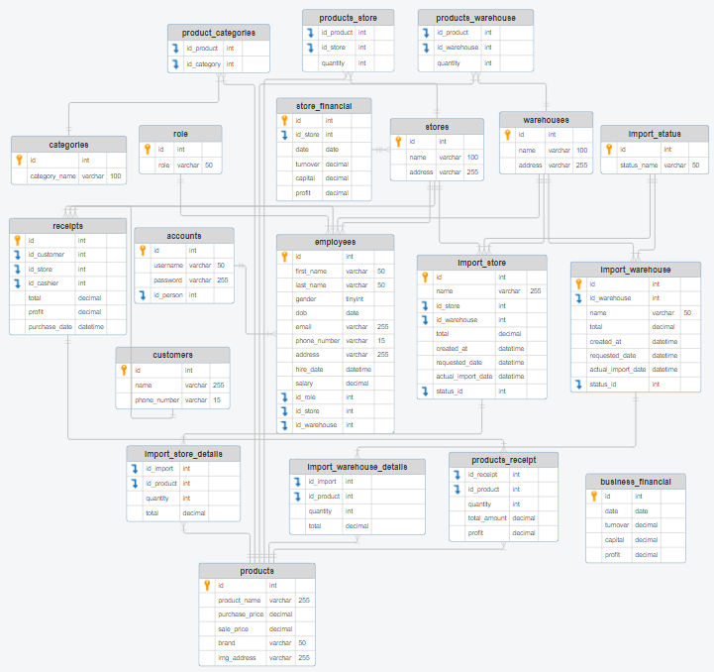
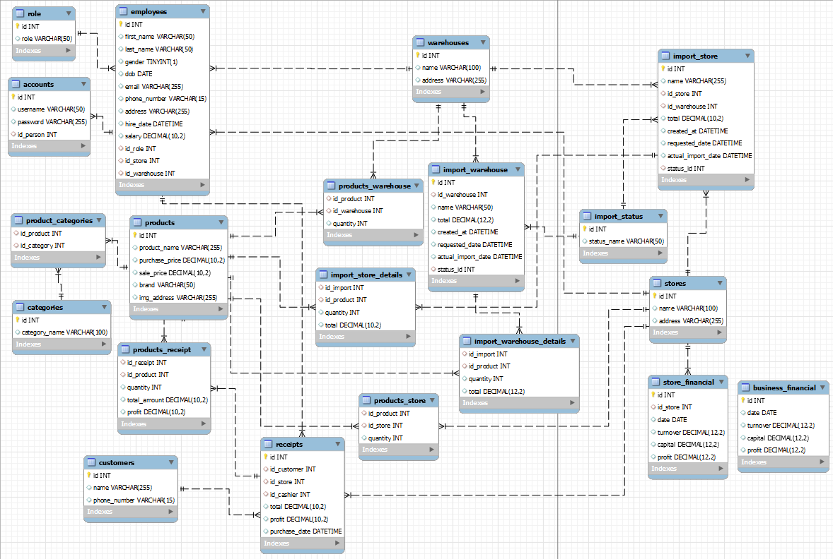
Introduction
ERD - Diagram
Pages and Functions
Future Development Direction

Slide 9
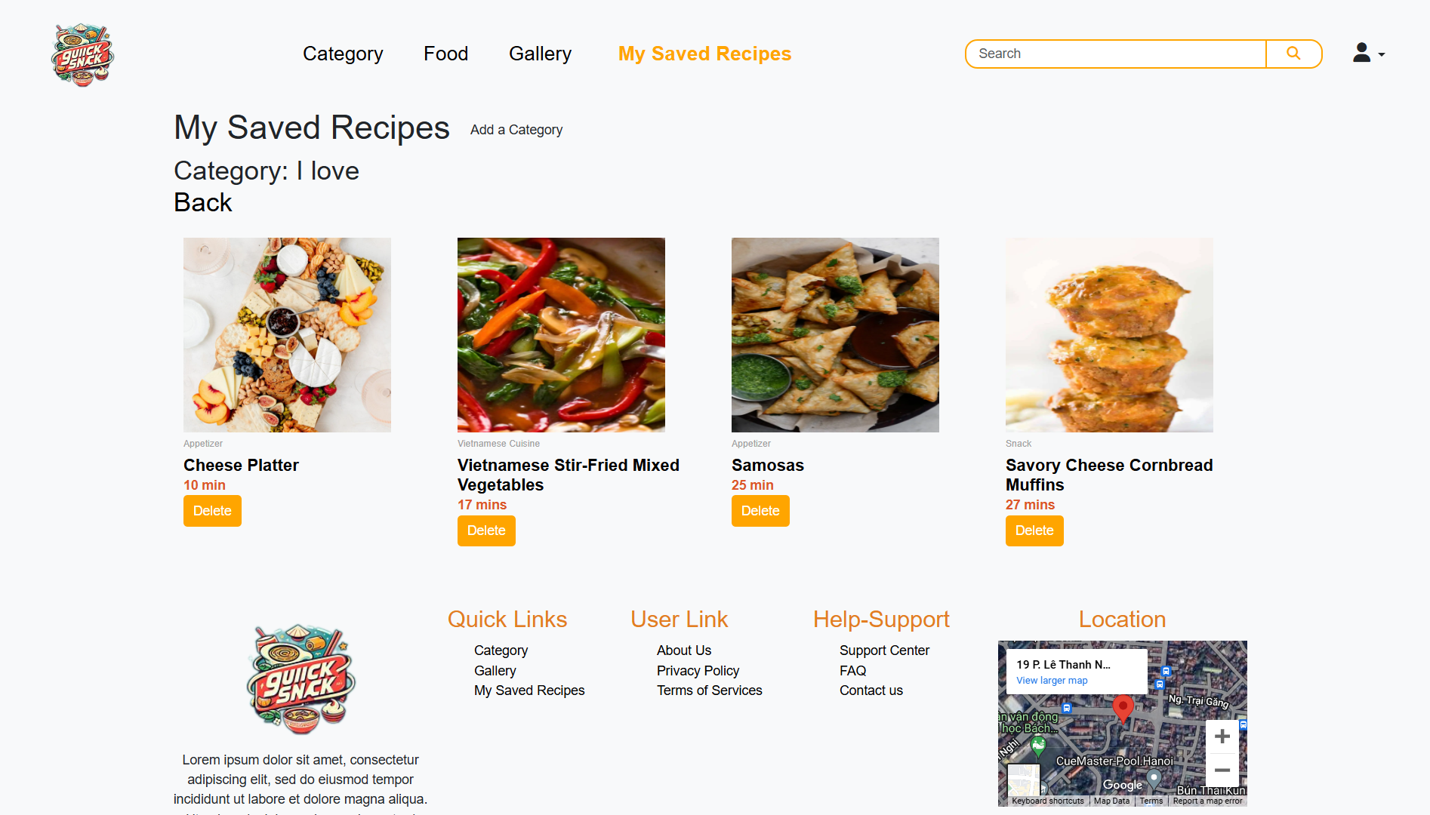
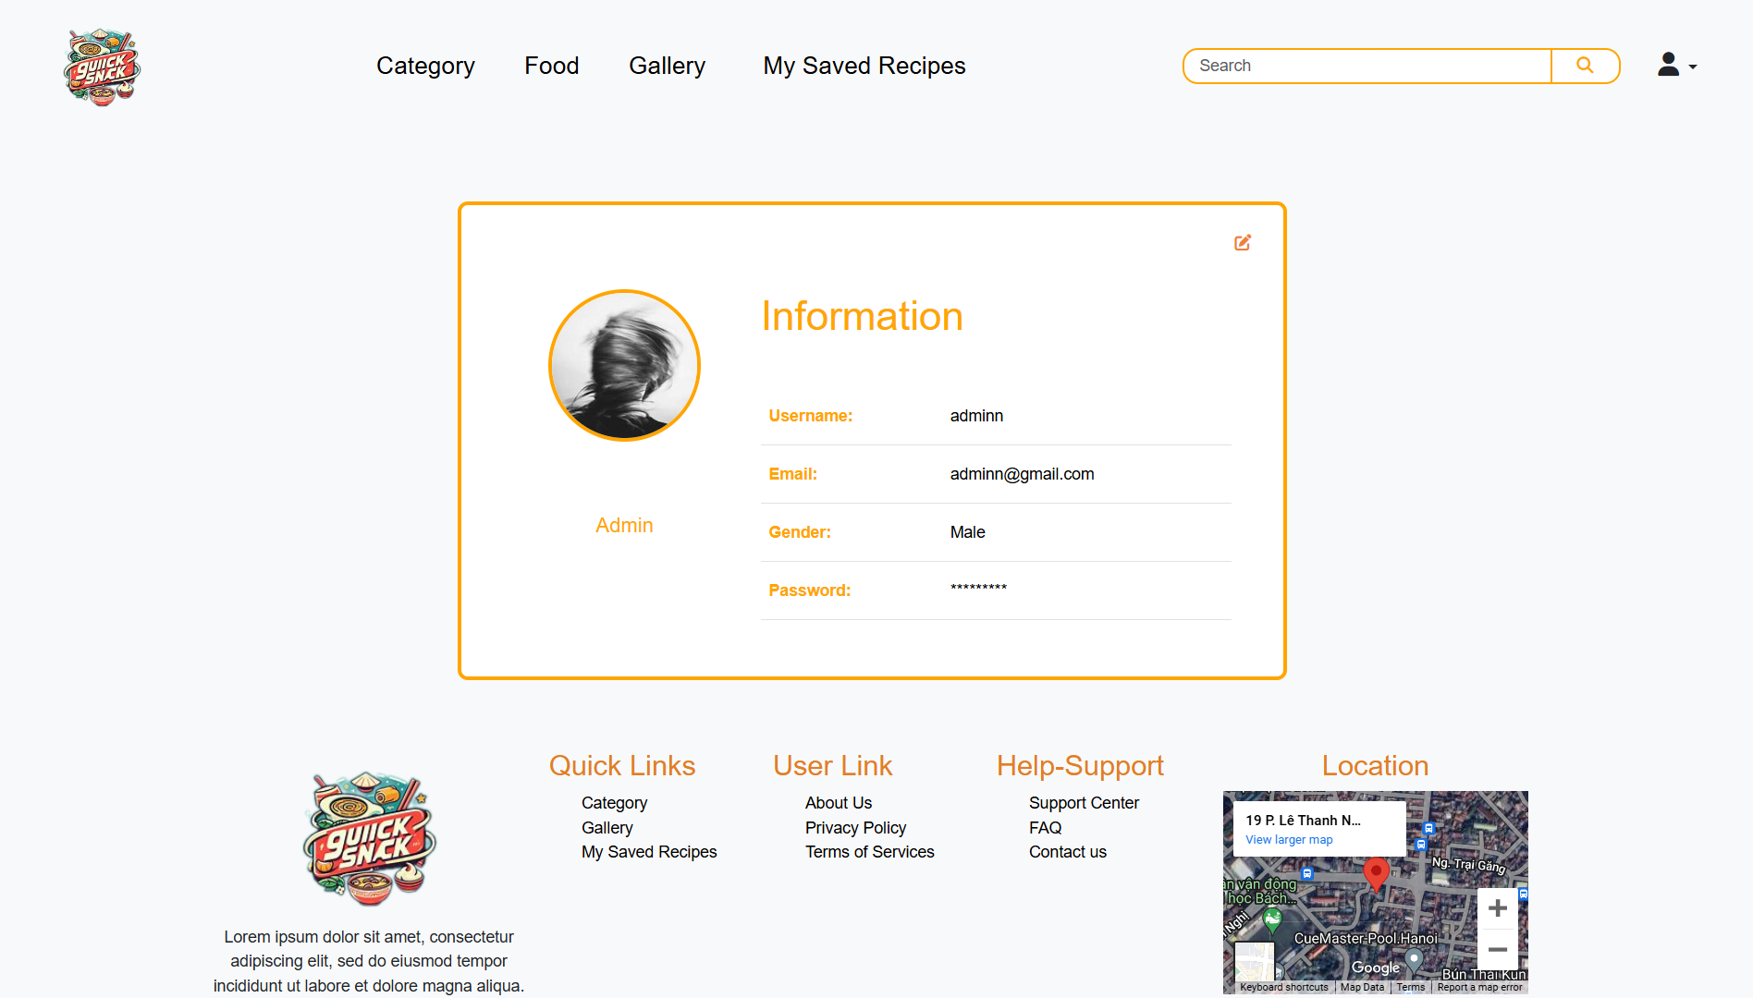
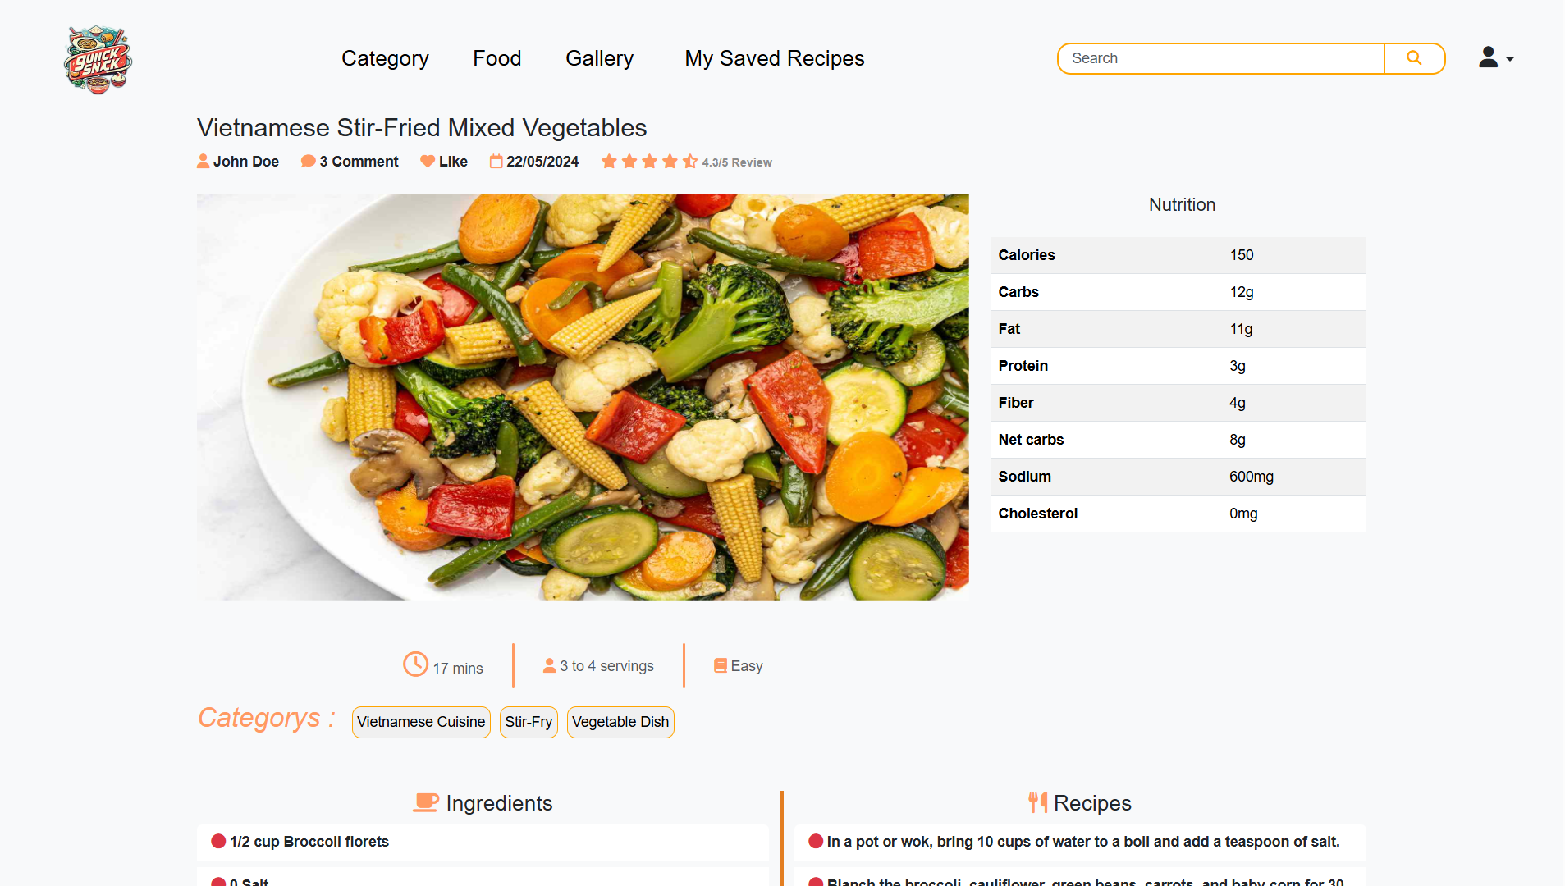
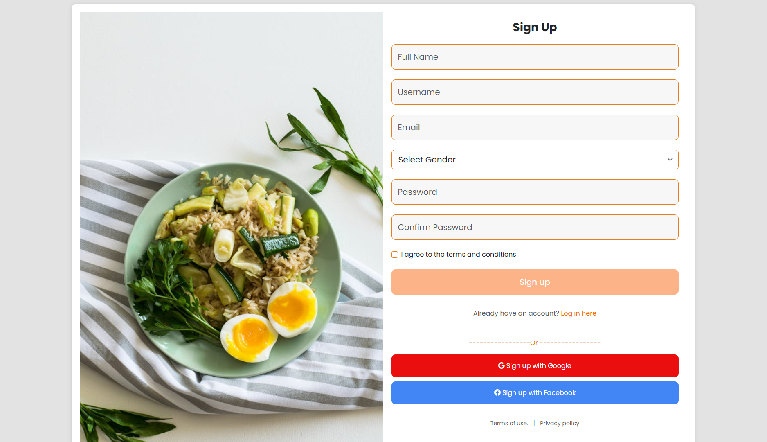
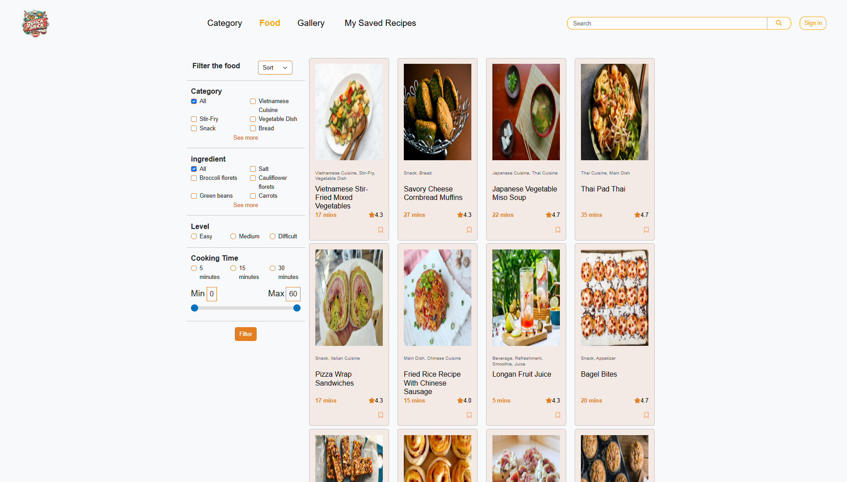
Introduction
Database - Diagram
Pages and Functions
Future Development Direction

Slide 10
Introduction
Database - Diagram
Pages and Functions
Future Development Direction
Improve User Interface (UI/UX):
Optimize the interface to be more user-friendly and easier to navigate.
Utilize modern design techniques to make the website more appealing and interactive.
Ensure compatibility across various devices and browsers.
Add New Features:
Integrate a rating and review system for each recipe, allowing users to share their experiences and opinions.
Develop a feature to suggest recipes based on available ingredients or user preferences.
Add tools to manage shopping lists and meal planning.
Create an Admin Page:
Build an administration page to manage content, recipes, and users.
Provide tools to monitor and analyze traffic and user activities.
Ensure that the admin page has a user-friendly interface, making it easy for administrators to perform management tasks.
Optimize Existing Features:
Enhance the performance and loading speed of the website.
Improve the accuracy and efficiency of the recipe search functions.
Ensure system stability and security.

Slide 11
Thanks You

